Slide 1

Part 3: Data Collection Methods and Feeding Back

Slide 2
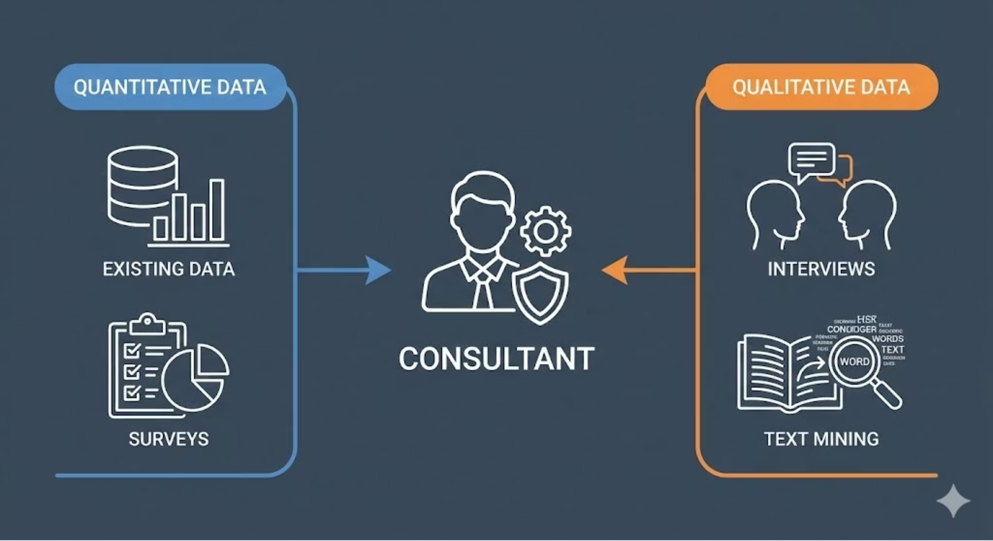
A wealth of options

Slide 3





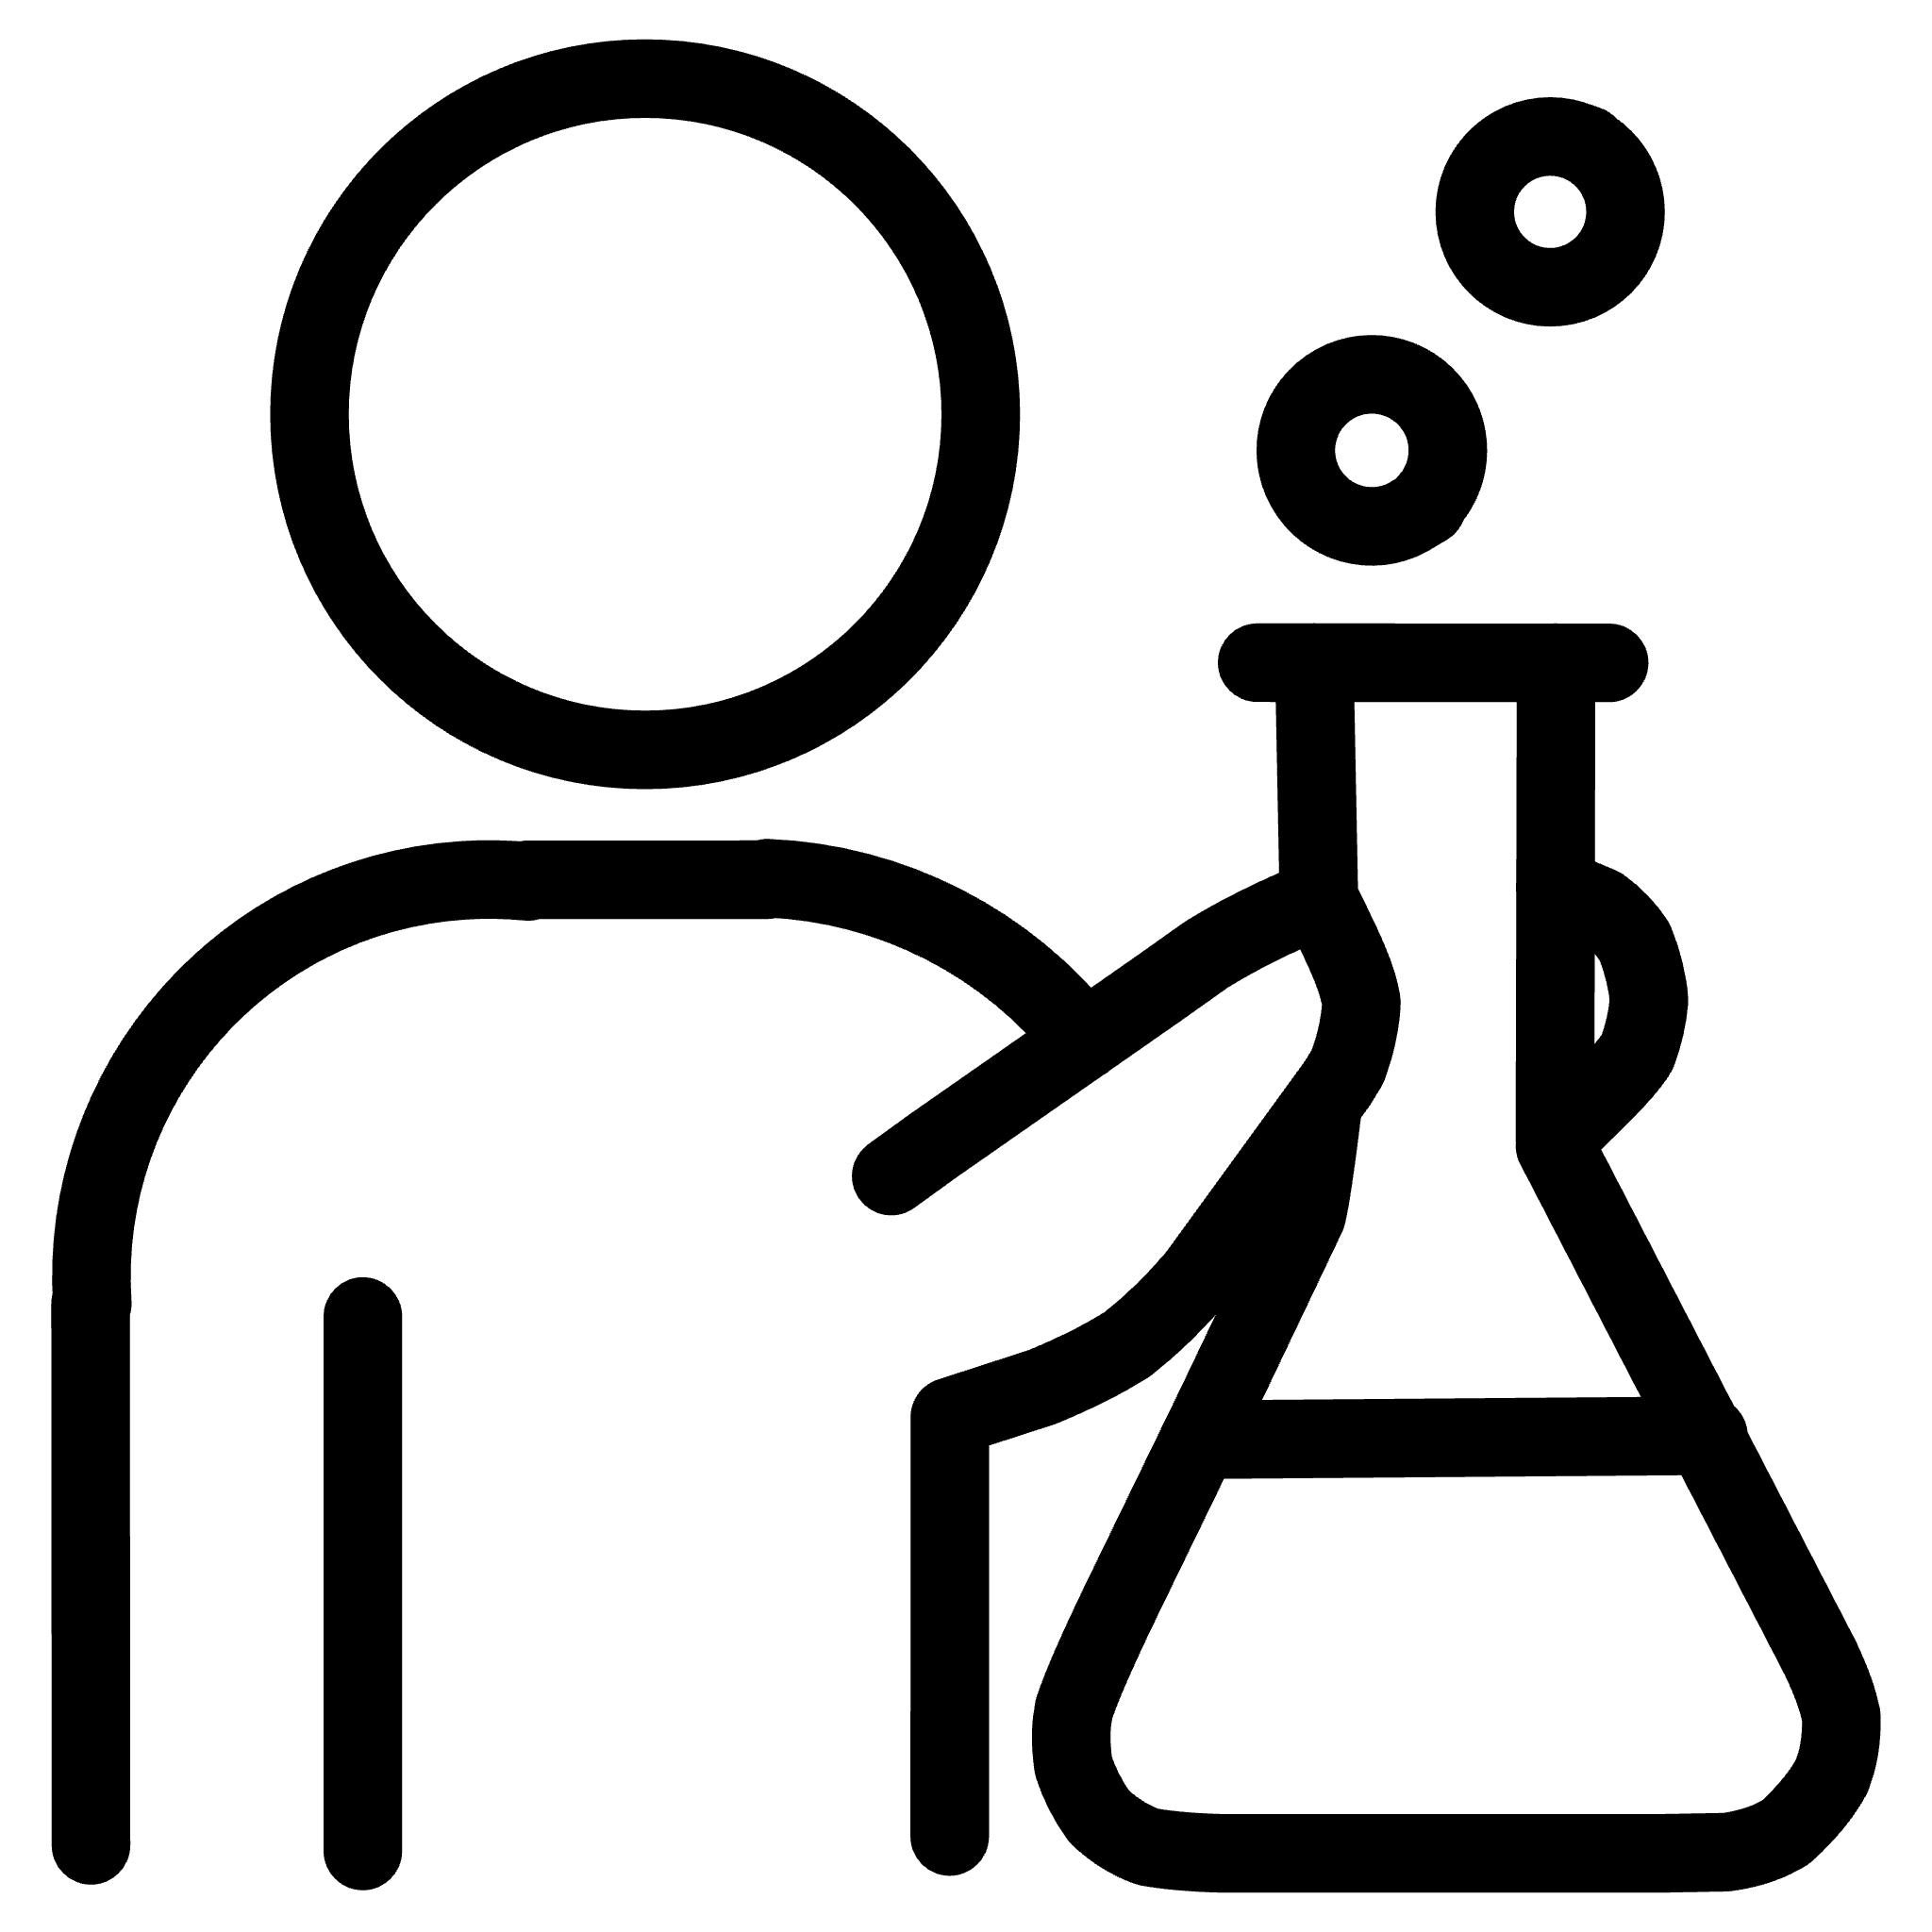
Common Data Collection Methods
Interviews
Questionnaires
Deep understanding and exploring unknowns.
Time-intensive; requires triangulation with other sources.
Large numbers and standardised data collection.
Consider response rates and question design carefully.
Focus Groups
Data & Document Analysis
Group dynamics and testing ideas.
Requires skilled facilitation; watch for group effects.
Relevant client data - e.g. HR analytics (check ethics and accuracy)
Policy documents and official positions (though may not reflect reality)
Observation
Experiments
Actual behaviour in context.
Be aware of observer effects on participants.
Establishing causation.
Often (but not always) impractical in consulting contexts.
Notes:
Triangulation is important - some methods also useful to show that you involve many people

Slide 4

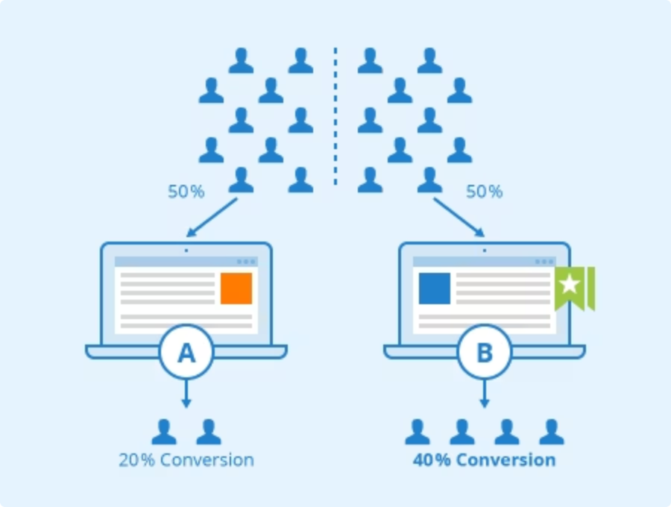

The Value of Experiments
Consultants aim to cause change, not merely describe it. Causal questions suggest experimental approaches.
Analytics reveals what happened; experiments demonstrate what works … but are rare and (often) hard to implement
Practical Ideas
Watch for "natural experiments" (requires creativity)
Create proof of concept before major rollout
Measure real reactions from actual individuals (talk is cheap)
Slowing down to test assumptions can accelerate overall progress.
Illustration by Seobility – License: CC BY-SA 4.0

Slide 5
AI may support the use of text data
LLM Text Analysis
AI-Driven Interviews
Document Mining (RAG)
Process interview transcripts, survey comments, and internal communications.
Conversational agents that adapt questions dynamically based on responses.
Query across policies, reports, and knowledge bases conversationally. Rapidly surface relevant insights from large document repositories.
Recent research demonstrates 77–96% agreement with human coders, saving time whilst maintaining quality.
Evidence suggests respondents may like it better than surveys - and may sometimes be more candid with AI.
Foundation for internal chatbots / knowledge bases
These tools excel at generating initial insights at scale, but human expertise remains essential, as does relational work.
AI can also speed up quantitative analyses - yet less transformative.

Slide 6




Ethics during data collection and diagnosis
Core Research Ethics Principles
Most of these principles should apply in consultancy, though commercial pressures can erode them.
Right to informed consent
Right to be fully informed
Right to privacy
How much deviation from these values that is compatible with your values and reputation - and with the clients' organisational health?
Right to withdraw
Right to safety
Rights to confidentiality/anonymity
Right not to be deceived
Consider UK GDPR data protection rules – they apply more strictly to consultancy than academic research
Avoidance of coercion

Slide 7


Slide 8

Feeding Back Findings
01
Co-Own the Data
Present findings as shared discoveries rather than expert verdicts delivered from on high.
02
Include Strengths
What's working well? Beginning with positives can create receptivity for challenges.
03
Be Specific and Grounded
Transform vague observations into concrete examples: "Communication is poor" becomes "Weekly meetings have no allocated time for collaborative problem-solving".
04
Invite Challenge
Create space for disagreement: client pushback is valuable data revealing underlying concerns.
Plan this when you plan data analysis – it shapes what you need to collect
Notes:
Data collection without effective feedback remains incomplete.
How you present findings shapes whether clients can hear and act upon them.

Slide 9

Participatory Feedback: Building Ownership
Gallery Walks
Co-Design Sessions
Prioritisation Exercises
Post findings on flip charts around the room.
Present emerging themes, then facilitate joint problem-solving workshops where solutions emerge collaboratively.
Involve clients in deciding what matters most.
Participants circulate, comments, and add insights before discussion begins.
Techniques like dot voting and impact-effort matrices.
Part 4 will explore positive approaches to diagnosis that can take this further

Slide 10



Your reflection
Think of a time you were asked to change something about how you work. What made the difference between a call to change you could hear versus one that triggered defensiveness?
COMING UP NEXT
Going deeper - and the value of looking at strengths
Notes:
It's not always "client has problem, calls consultant." Sometimes consultants create the problem. We'll look at farming versus hunting, and a framework called the Pyramid of Trust.

